Slide 1

RV College of
Engineering
INTRODUCTION TO PYTHON PROGRAMMING
UNIT III

Slide 2
RV College of
Engineering
For loops
A for loop is used for iterating over a particular sequence (can be a list, a tuple, a dictionary, a set, or a string).
This is less like the for keyword in other programming languages
Similar to an iterator method as found in other object-orientated programming languages.
With the for loop a set of statements, once for each item in a list, tuple, set etc can be executed.
Used for sequential traversal.

Slide 3
RV College of
Engineering
A simple ‘for’ loop
Syntax:
for iterator_var in sequence:
statements(s)
Example 1: output: 0 1 2 3
n = 4
for i in range(0, n):
print(i)
Example 2: output: 4 3 2 1 stop!
for i in [4, 3, 2, 1] :
print(i)
print(‘stop!')

Slide 4
Example 3
RV College of
Engineering
friends = ['Joseph', 'Glenn', 'Sally']
for friend in friends :
print(‘Hello:', friend)
print('Done!’)
Output:
Hello: Joseph Hello: Glenn
Hello: Sally
Done!

Slide 5
Example 4
RV College of
Engineering
fruits = ["apple", "banana", "cherry"] for x in fruits: print(x)
Loop through the letters in the word "banana":
for x in "banana": print(x)

Slide 6
RV College of
Engineering
Nested Loops
Loops Inside Loops
A nested loop is a loop inside a loop.
The "inner loop" will be executed one time for each iteration of the "outer loop":
adj = ["red", "big", "tasty"] fruits = ["apple", "banana", "cherry"] for x in adj: for y in fruits: print(x, y)

Slide 7
RV College of
Engineering
Control Statements
Break
Continue
Pass

Slide 8
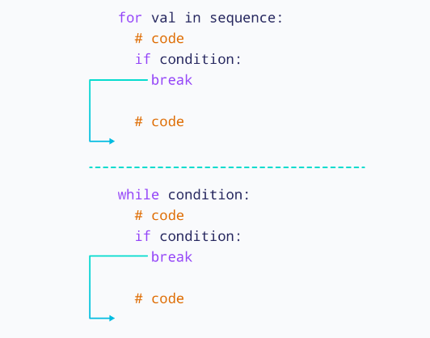
RV College of
Engineering
Break Statement
The break statement is used to terminate the loop immediately when it is encountered.
The syntax of the break statement is

Slide 9
RV College of
Engineering
Break Statement
With the break statement we can stop the loop before it has looped through all the items:
fruits = ["apple", "banana", "cherry"]
for x in fruits:
if x == "banana":
break
print(x)
fruits = ["apple", "banana", "cherry"]
for x in fruits:
print(x)
if x == "banana":
break

Slide 10
RV College of
Engineering
Break Statement
# program to find first 5 multiples of 6
i = 1
while i <= 10:
print('6 * ',(i), '=',6 * i)
if i >= 5:
break
i = i + 1

Slide 11
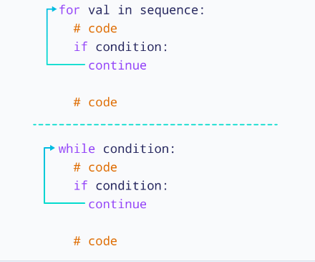
RV College of
Engineering
Continue Statement

Slide 12
RV College of
Engineering
Continue Statement
Python continue Statement with for Loop
We can use the continue statement with the for loop to skip
the current iteration of the loop.
Then the control of the program jumps to the next iteration.
For example,
for i in range(5):
if i == 3:
continue
print(i)

Slide 13
RV College of
Engineering
Continue Statement
Python continue Statement with While Loop
We can use the continue statement with the While loop to skip
the current iteration of the loop.
Then the control of the program jumps to the next iteration.
For example,
num = 0
while num < 10:
num += 1
if (num % 2) == 0:
continue
print(num)

Slide 14
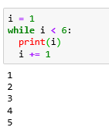
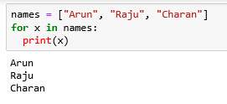
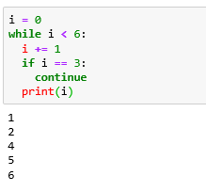
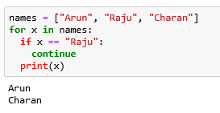
RV College of
Engineering
Continue Statement
While Loop
for Loop

Slide 15
RV College of
Engineering
Pass Statement
In Python programming, the pass statement is a null statement
which can be used as a placeholder for future code.
Suppose we have a loop or a function that is not
implemented yet, but we want to implement it in the future.
In such cases, we can use the pass statement.
The syntax of the pass statement is : pass
n = 10
# use pass inside if statement
if n > 10:
pass
print('Hello')

Slide 16
RV College of
Engineering
Strings
Accessing Strings
Basic Operations
String slices
Function and Methods

Slide 17
RV College of
Engineering
Strings
String Initialization
a='Welcome, to RVCE!'
b = "Welcome, to RVCE!"
c="""Welcome,
to RVCE!""“
Accessing characters in a string
a[1]

Slide 18
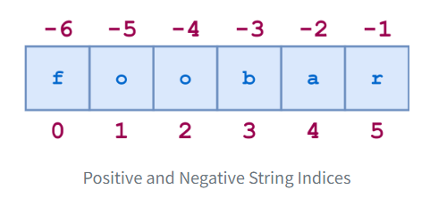
Strings
RV College of
Engineering
Strings
String Indexing
Let us say we have word “foobar”
String indexing in Python is zero-based: the first character
in the string has index 0, the next has index 1, and so on

Slide 19
Strings
RV College of
Engineering
Strings
The individual characters can be accessed by index as follows:
>>> s = 'foobar'
>>> s[0]
'f'
>>> s[1]
'o'
>>> s[-1]
‘r'

Slide 20
Strings
RV College of
Engineering
Strings
The individual characters can be accessed by index as follows:
>>> s = 'foobar'
>>> s[0]
'f'
>>> s[1]
'o'
>>> s[-1]
‘r'

Slide 21
Strings
RV College of
Engineering
String Slicing
Python also allows a form of indexing syntax that extracts substrings from a string, known as string slicing.
If s is a string, an expression of the form s[m:n] returns the portion of s starting with position m, and up to but not including position n:
a='Welcome, to RVCE!'
print(a)
print(a[2:11])
print(a[2:]) -- if you omit the second index as in s[n:], the slice extends from the first index through the end of the string.
print(a[:3]) -- If you omit the first index, the slice starts at the beginning of the string. Thus, s[:m] and s[0:m] are equivalent

Slide 22
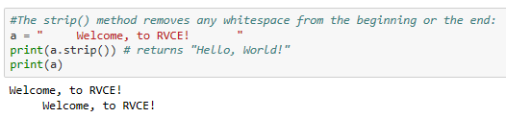
String- In built functions
RV College of
Engineering
strip() -- removes whitespace from the beginning or end
a = “ Welcome, to RVCE! “
print(a.strip())

Slide 23

String- In built functions
RV College of
Engineering
len() -- returns the length of a string
a = “ Welcome, to RVCE! “
print(len(a))

Slide 24
String- In built functions
RV College of
Engineering
The split() method splits a string into a list.
You can specify the separator, default separator is any whitespace.
Syntax
string.split(‘separator’, maxsplit)
string.split ()
Parameter | Description
separator | Optional. Specifies the separator to use when splitting the string. By default any whitespace is a separator
maxsplit | Optional. Specifies how many splits to do.

Slide 25
String- In built functions
RV College of
Engineering
# Defining both Separator and MaxSplit
a = " Welcome, to, RVCE! "
print(a)
print(a.split(',',1))
#No Maxsplit is Specified
a = "Welcome,to, RVCE!"
print(a)
print(a.split(','))
#No Sepreator and Maxsplit are specified
a = "Welcome,to, RVCE!"
print(a)
print(a.split())

Slide 26



String- In built functions
RV College of
Engineering
lower() -- returns the lower case of the string
upper() -- returns the upper case of the string
lower() -- returns the replaced string

Slide 27
String manipulation functions
RV College of
Engineering
capitalize() Capitalizes first letter of string
Eg: Syntax: string_name.capitalize()
Parameter: The capitalize() function does not takes any parameter.
Return: The capitalize() function returns a string with the first character in the capital.
Eg: name = "geeks FOR geeks"
print(name.capitalize())
Output:
Geeks for geeks

Slide 28
String manipulation functions
RV College of
Engineering
centre (width, fillchar)
Python String center() method creates and returns a new string that is padded with the specified character.
Syntax: string.center(length[, fillchar])
Parameters:
length: length of the string after padding with the characters.
fillchar: (optional) characters which need to be padded. If it’s not provided, space is taken as the default argument.
Returns: Returns a string padded with specified fillchar and it doesn’t modify the original string.

Slide 29
String manipulation functions
RV College of
Engineering
centre (width, fillchar)
Python String center() method creates and returns a new string that is padded with the specified character.
Syntax: string.center(length[, fillchar])
string = "geeks for geeks"
new_string = string.center(24, '#')
print(new_string)
If the length argument value is less than original String length, then the string is unchanged

Slide 30
String manipulation functions
RV College of
Engineering
Count : The count() method returns the number of times a specified value appears in the string.
Syntax
string.count(value, start, end)
Parameter Values
Parameter | Description
value | Required. A String. The string to value to search for
start | Optional. An Integer. The position to start the search. Default is 0
end | Optional. An Integer. The position to end the search. Default is the end of the string

Slide 31
String manipulation functions
RV College of
Engineering
txt = "I love apples, apple are my favorite fruit"
x = txt.count("apple", 10, 24)
print(x)

Slide 32
String manipulation functions
RV College of
Engineering
endswith:
The endswith() method returns True if a string ends with the specified suffix. If not, it returns False.
The syntax
str.endswith(suffix[, start[, end]])
Example
message = 'Python is fun'
# check if the message ends with fun
print(message.endswith('fun'))

Slide 33
String manipulation functions
RV College of
Engineering
Find: The find() method returns the index of first occurrence of the substring (if found). If not found, it returns -1.
The syntax of the find() method is:
str.find(sub[, start[, end]])
The find() method takes maximum of three parameters:
sub - It is the substring to be searched in the str string.
start and end (optional) - The range str[start:end] within which substring is searched.
Eg : message = 'Python is a fun programming language'
# check the index of 'fun'
print(message.find('fun'))
# Output: 12

Slide 34
String manipulation functions
RV College of
Engineering
isalnum()Returns true if string has at least 1 character and all characters are alphanumeric and false otherwise.
# string contains either alphabet or number
name1 = "Python3"
print(name1.isalnum()) #True
# string contains whitespace
name2 = "Python 3"
print(name2.isalnum()) #False
isdigit()Returns true if string contains only digits and false otherwise.
islower()Returns true if string has at least 1 cased character and all cased characters are in lowercase and false otherwise.
isspace()Returns true if string contains only whitespace characters and false otherwise.

Slide 35
String manipulation functions
RV College of
Engineering
isdigit()Returns true if string contains only digits and false otherwise.
Example:
str1 = '342'
print(str1.isdigit())
str2 = 'python'
print(str2.isdigit())
# Output: True and False respectively

Slide 36
String manipulation functions
RV College of
Engineering
islower() The islower() method returns True if all alphabets in a string are lowercase alphabets. If the string contains at least one uppercase alphabet, it returns False
s = 'this is good'
print(s.islower())
s = 'th!s is aLso g00d'
print(s.islower())
s = 'this is Not good'
print(s.islower())

Slide 37
String manipulation functions
RV College of
Engineering
isspace()Returns true if string contains only whitespace characters and false otherwise.
str1 = ' '
print(str1.isspace())

Slide 38
String Formatting Operator
RV College of
Engineering
%c for character
%s for strings
%d for numbers
%x for hexadecimal numbers
%f for floating point numbers
print('Joe stood up and %s to the crowd.' %'spoke')
print('There are %d dogs.' %4)

Slide 39
Tuples in Python
RV College of
Engineering
Tuples are ordered collections of heterogeneous data that are unchangeable. Heterogeneous means tuple can store variables of all types.
Tuple has the following characteristics
Ordered: Tuples are part of sequence data types, which means they hold the order of the data insertion. It maintains the index value for each item.
Unchangeable: Tuples are unchangeable, which means that we cannot add or delete items to the tuple after creation.
Heterogeneous: Tuples are a sequence of data of different data types (like integer, float, list, string, etc;) and can be accessed through indexing and slicing.
Contains Duplicates: Tuples can contain duplicates, which means they can have items with the same value

Slide 40
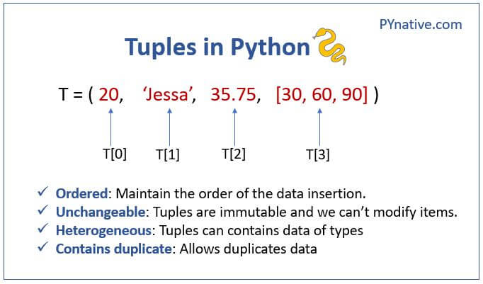
Tuples in Python
RV College of
Engineering

Slide 41
Creating tuple
RV College of
Engineering
A tuple is created by placing all the items (elements) inside parentheses (), separated by commas. The parentheses are optional, however, it is a good practice to use them.
A tuple can have any number of items and they may be of different types (integer, float, list, string, etc.).
Eg : my_tuple = (1, "Hello", 3.4)
print(my_tuple)
In Python, creating a tuple with one element is a bit tricky. Having one element within parentheses is not enough.
We will need a trailing comma to indicate that it is a tuple,
var1 = ("Hello") # This is string
var2 = ("Hello",) # This is tuple

Slide 42
Accessing Values in Tuple
RV College of
Engineering
You can access tuple items by referring to the index number, inside square brackets:
thistuple = ("apple", "banana", "cherry")
print(thistuple[1])
print(thistuple[-3])
Print(thistuple[0:2])

Slide 43
Updating values in Tuple
RV College of
Engineering
Tuples are immutable which means you cannot update or change the values of tuple elements.
But there are some Hacks
Add tuple to a tuple. You are allowed to add tuples to tuples, so if you want to add one item, (or many), create a new tuple with the item(s), and add it to the existing tuple:
Example :
thistuple = ("apple", "banana", "cherry")
y = ("orange",)
thistuple += y
print(thistuple)

Slide 44
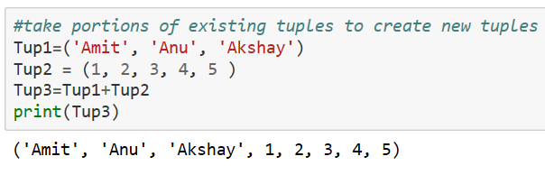
Updating values in Tuple
RV College of
Engineering

Slide 45
Delete Tuple Elements
RV College of
Engineering
We will be using the operator called del
thistuple = ("apple", "banana", "cherry")
print(thistuple)
del thistuple # This deletes the tuple
print(thistuple)

Slide 46
Basic Tuples Operations
RV College of
Engineering
Tuples respond to the + and * operators much like strings; they mean concatenation and repetition here too, except that the result is a new tuple, not a string.
Example Code
thistuple = ("apple", "banana", "cherry")
y = (1,2,3)
print(len(thistuple))
print (thistuple+y)
print(y*2)
print(2 in y)
for x in y:
print(x)
Python Expression | Results | Description
len((1, 2, 3)) | 3 | Length
(1, 2, 3) + (4, 5, 6) | (1, 2, 3, 4, 5, 6) | Concatenation
('Hi!',) * 4 | ('Hi!', 'Hi!', 'Hi!', 'Hi!') | Repetition
3 in (1, 2, 3) | True | Membership
for x in (1, 2, 3): print x, | 1 2 3 | Iteration

Slide 47
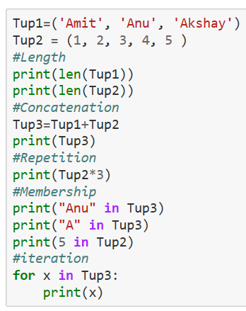
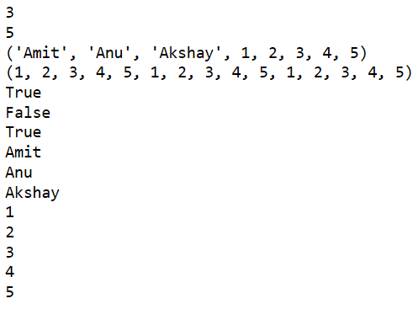
Basic Tuples Operations
RV College of
Engineering

Slide 48
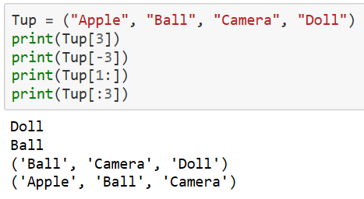
Indexing, Slicing, and Matrixes
RV College of
Engineering

Slide 49
Built-in Tuple Functions
RV College of
Engineering
Sr.No. | Function with Description |  | Code
1 | cmp(tuple1, tuple2)Compares elements of both tuples.
2 | len(tuple)Gives the total length of the tuple.
3 | max(tuple)Returns item from the tuple with max value.
4 | min(tuple)Returns item from the tuple with min value.
5 | tuple(seq)Converts a list into tuple.

Slide 50
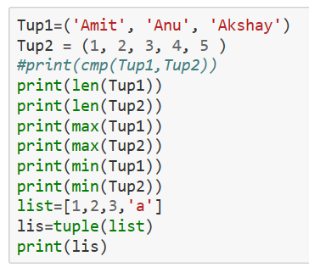
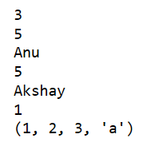
Built-in Tuple Functions
RV College of
Engineering

Slide 51
Lists in Python
RV College of
Engineering
Lists are used to store multiple items using a single variable.
Lists is a built-in data types
Lists are used to store collections of data,
List items are ordered, changeable, and allow duplicate values.
List items are indexed, the first item has index [0], the second item has index [1] and so on
List items can be of any data type
Example : list1 = ["abc", 34, True, 40, "male","abc"]

Slide 52
Lists in Python
RV College of
Engineering
list = [ 'abcd', 786 , 2.23, 'john', 70.2 ]
tinylist = [123, 'john’]
print (list) # Prints complete list
print (list[0]) # Prints first element of the list
print (list[1:3]) # Prints elements starting from 2nd till 3rd
print (list[2:]) # Prints elements starting from 3rd element
print (tinylist * 2) # Prints list two times
print (list + tinylist) # Prints concatenated lists

Slide 53
Lists in Python
RV College of
Engineering
Output:
['abcd', 786, 2.23, 'john', 70.2]
abcd
[786, 2.23]
[2.23, 'john', 70.2]
[123, 'john', 123, 'john’]
['abcd', 786, 2.23, 'john', 70.2, 123, 'john']

Slide 54
Basic Operations of Lists in Python
RV College of
Engineering
1. The append() method adds an item at the end of the list
numbers = [21, 34, 54, 12]
numbers.append(32)
print(numbers)
2. The insert() method inserts an element to the list at the specified index
Syntax : list.insert(postion, item)
Eg:
numbers = [21, 34, 54, 12]
numbers.insert(0, 32)
print(numbers)
Add Elements to a Python List

Slide 55
Basic Operations of Lists in Python
RV College of
Engineering
To Remove Elements
The syntax of the remove() method is:
list.remove(element)
Eg: numbers = [21, 34, 54, 12]
numbers.remove(34)
print(numbers)
If a list contains duplicate elements, the remove() method only removes the first matching element.
If you need to delete elements based on the index (like the fourth element), you can use the pop() method. Eg : numbers.pop(0)

Slide 56
Dictionary
RV College of
Engineering
Dictionaries are used to store data values in key:value pairs.
A dictionary is a collection which is ordered*, changeable and do not allow duplicates
Key is separated from its value by a colon (:)
Items are separated by commas
Dictionary is enclosed in curly braces
Keys are unique within a dictionary while values may not be.
thisdict = {"brand": "Ford","model": "Mustang","year": 1964}

Slide 57
Accessing Values in Dictionary
RV College of
Engineering
To access dictionary elements, you can use the familiar square brackets along with the key to obtain its value. Following is a simple example −
dict = {'Name': 'Zara', 'Age': 7, 'Class': 'First'}
print (dict['Name’])
print (dict['Age'])
If we attempt to access a data item with a key, which is not part of the dictionary, we get an error as follows
print (dict[‘Height'])

Slide 58
Updating Dictionary
RV College of
Engineering
You can update a dictionary by adding a new entry or a key-value pair, modifying an existing entry, or deleting an existing entry as shown below in the simple example
dict = {'Name': 'Zara', 'Age': 7, 'Class': 'First'}
dict['Age'] = 8; # update existing entry
dict['School'] = "DPS School"; # Add new entry

Slide 59
Delete Dictionary Elements
RV College of
Engineering
You can either remove individual dictionary elements or clear the entire contents of a dictionary. You can also delete entire dictionary in a single operation
1. To remove individual dictionary elements
: We will use del on Key element which has to be removed
Eg :
dict = {'Name': 'Zara', 'Age': 7, 'Class': 'First'}
del dict['Name']; # remove entry with key 'Name‘
2. To Clear the contents of dictionary : I will use the function clear
dict.clear(); # remove all entries in dict
3. To delete entire dictionary : del dict

Slide 60
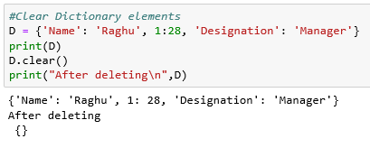
Clear Dictionary elements
RV College of
Engineering

Slide 61
Properties of Dictionary Keys
RV College of
Engineering
Dictionary values have no restrictions. They can be any arbitrary Python object, either standard objects or user-defined objects.
There are two important points to remember about dictionary keys −
(a) More than one entry per key not allowed. Which means no duplicate key is allowed. When duplicate keys encountered during assignment, the last assignment wins.
For example − dict = {'Name': 'Zara', 'Age': 7, 'Name': 'Manni'}
print (dict['Name'])

Slide 62
Properties of Dictionary Keys
RV College of
Engineering
Keys must be immutable. Which means you can use strings, numbers or tuples as dictionary keys but something like ['key'] is not allowed.
Following is a simple example
dict = {['Name']: 'Zara', 'Age': 7}
print (dict['Name']) # You will get the error

Slide 63
Built-in Dictionary Functions
RV College of
Engineering
len(dict) Gives the total length of the dictionary
str(dict) Produces a string representation of dictionary
type(variable) Returns the type of the passed variable.
dict = {'Name': 'Zara', 'Age': 7};
print(len (dict))
dict = {'Name': 'Zara', 'Age': 7};
print(str (dict))
dict = {'Name': 'Zara', 'Age': 7};
print(type (dict))

Slide 64
Built-in dictionary methods
RV College of
Engineering
Function | Explanation | Syntax | Example /Code
copy() | returns a shallow copy of the dictionary. | dict.copy() | dict1 = {'Name': 'Zara', 'Age': 7}; dict2 = dict1.copy() print(dict2)
get() | returns a value for the given key | dict.get(key) | dict1 = {'Name': 'Zara', 'Age': 7}; print(dict.get(‘Name’))
has_key() | returns true if a given key is available in the dictionary, otherwise it returns a false. | dict.has_key(key) | dict1 = {'Name': 'Zara', 'Age': 7}; print(dict.has_Key(‘Name’))
update() | adds dictionary dict2's key-values pairs in to dict |  | dict = {'Name': 'Zara', 'Age': 7} dict2 = {'School': ‘ABC' } dict.update(dict2) Print(dict)
keys() | returns a list of all the available keys in the dictionary. | dict.keys | dict = {'Name': 'Zara', 'Age': 7} print(dict.keys())

Slide 65
RV College of
Engineering
THANK YOU

